Slide 1


WELCOME TO
Notes:
APPROPRIATE TITLE FOR YOUR SEMINAR AND YOUR SHOW LOGO GOES HERE

Slide 2
BIG NEWS!!!
2016 Minneapolis Home + Garden Show
  Feb 26th – 28th
  AND
  Mar 4th – 6th 2016

Slide 3


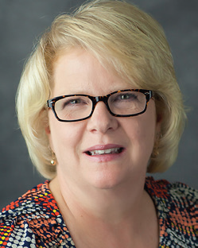

Introduction
  Marketplace Events
    42 Shows in 20 Markets
  The Team
    Jennifer Sorensen, Exhibit Sales Consultant
    Jill Kottke, Exhibit Sales Consultant
    Erika Knuth, Show|Office Administrator
    Martin Egli, Show Manager
    Seana Wall, Marketing Coordinator, U.S.
    Brent Keller, Vice President
    Joe Trimble, Regional Sales Director
    Kevin Grace, Operations Manager

Slide 4

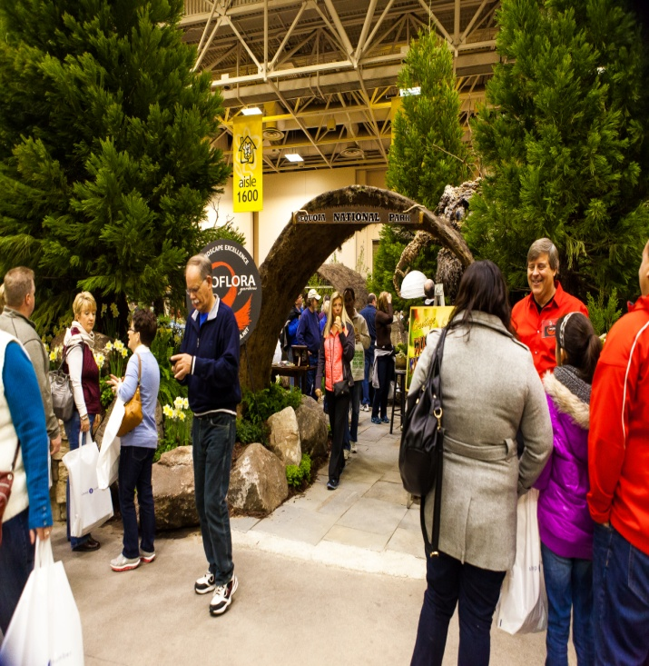
Today’s Agenda
  2014 Show Overview
  2015 Show Updates
  Marketing Research and Opportunities
    Research, Creative, Opportunities and more
  Sponsorship and Features
  Exhibit Like an Expert –
    Joe Trimble, Regional Sales Director
    Marketplace Events

Slide 5

Who Attends?

Slide 6
Who Attends?
  95% are homeowners
  91% attend with a project in mind
  96% did not attend another home show in the market
  75% are in the 35-64 age bracket
  76% attend with spouse – You meet BOTH decision makers!
  49% Plan to spend $1,000+ with and exhibitor within 12 months
  75% Spent between 3 and 6 hours at the show
  30% came to shop for a SPECIFIC product or service
Plus…
94% of attendees rated the value
they received from the show as
Excellent, Very Good, Good or Fair!
Notes:
Minn 14
34% landscape/outdoor project
32% kitchen/bath remodel
11% home décor/design project

Slide 7

We Guarantee Customer Satisfaction!
  Promoted/communicated via multiple methods:
    Print Ads, Email, Online, PR
Notes:
Does this not speak to how confident we are in our shows?
Have you ever seen this before?
We do get a couple every show.
A little old lady holding two large bags, saying she didn’t find anything she liked at the show…
Des Moines – Staying late… Exhibitor wasn’t there to buy from

Slide 8


2015 Show Updates
  Feature Gardens Presented by Star Tribune
    – Gardens theme: Twin Cities best backyards!
  Idea Home – Viebrock Construction
  Celebrity Appearances
    Ty Pennington
    Beekman Boys
  Lifestyle Stage & Cooking Stage
  Innovation Avenue
    New Products!!!
  Spring Boutique
  Garden Theatre – Presented by
    Minnesota State Horticultural Society

Slide 9

Maximizing Your Show Experience
Through Marketing

Slide 10
Media Plan Highlights
  Strategic Media Campaign
    Utilizing detailed research from 2014
    Strong partnerships with key media
  Promotions & Contest Highlights
    Unique tie-ins with all media partners
  PR Plan
    Developed based on key learnings from 2014
TOTAL VALUE
In Excess of $1,000,000!

Slide 11
2014 Show Marketing
How did consumers hear about the show?
TV 41%
Newspaper 23%
Radio 25%
Online 21%
Email 19%
Friend or Relative 11%
Magazine 3%
Billboard/Poster 11%
Exhibitor 2.5%

Slide 12

PRIMARY STRATEGIES
Media Relations & Publicity
We maximize each medium to its fullest
    TV
    Radio
    Direct Mail
    Online
    Billboards
    Magazines
  Promotional value higher
  when include PR efforts.

Slide 13
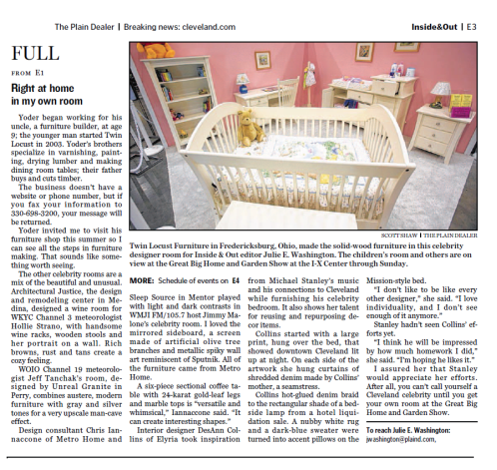
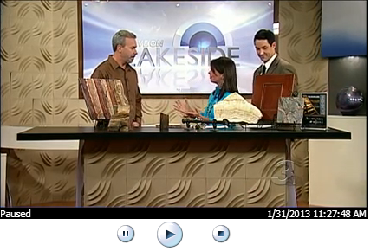

PR AGENCY added value
Live on Lakeside
1/31/2013 11:27 a.m.

Slide 14
Driving Traffic through
our Show Website
19,835 tickets sold online through our website for 2014 show
  Top 5 visited pages on website
    Home Page
    Exhibitor List
    Sponsors Page
    Ticket Prices
    General Info – Dates/Hours/Location

Slide 15

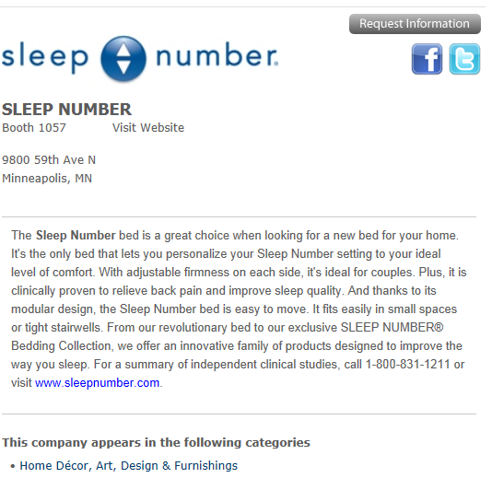
Buyers Guide Listing
Grow your business through our website
A resource where buyers can search for by company name, category or product throughout the year
Before, during and throughout the year

Slide 16


PROMOTE YOUR PARTICIPATION
In Your Company’s Own Marketing & Advertising
  Include “VISIT US AT THE HOME SHOW, BOOTH #123” in your existing advertising…
  Email Signature and Voicemail messaging
  Your website
  Your Facebook page
  Your Twitter site
  Forward the show’s email blasts
  to your company’s consumer contact list.

Slide 17









Sponsors To Date

Slide 18
Why Sponsor?
Elevate your presence before and during the Event by setting yourself apart from the competition.
We customize to reach your marketing goals and fit within your budget.
  Drive booth traffic
  Drive consumers back to your retail locations and websites
  Product/service awareness
  Increase brand loyalty
  Reinforce image
  Close sales on show floor
  Gather qualified leads which results in sales
  Invaluable research information

Slide 19
Marketing Opportunities at Affordable Pricing
Marketing Opportunities
vs. Sponsorships
Ask your Exhibit Sales Consultant
From $300 and up

Slide 20



Engage With Us!
“Like” Home and Garden Events
facebook.com/homeandgardenevents
Follow us: Twitter: @HomeShowMPLS
Pinterest: pinterest.com/homeshows
Blog – HomeandGardenBlog.com

Slide 21
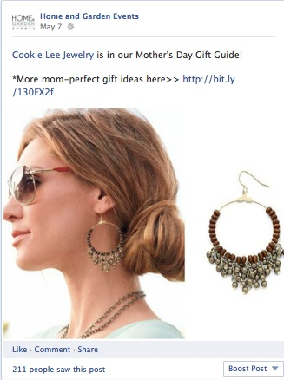


Holiday Gift Guides on Facebook
Our gift guides are set up in catalogue form, then cross-promoted on our Facebook timeline to maximize exposure .

Slide 22

Exhibitor Spotlight
An example of a cross-promoted Exhibitor Spotlight on Facebook.

Slide 23
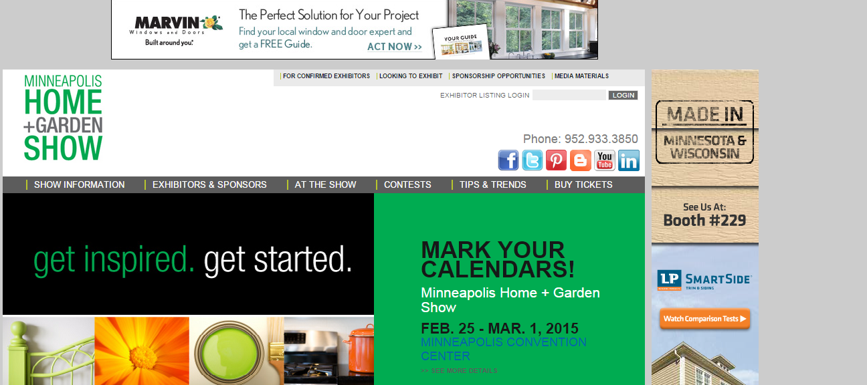
Banner Ads
(Top of Page & Towers Ads) From $550 - $750

Slide 24

Email Blasts
to Show Consumer Database - from $300
What this Means for the 35,000+ Members of our Database:
Valuable + Inspirational Tips from Celebs, Highlights of Show Features + Other Entertaining Content
    YOUR banner ad in consumer email to 35,000 opted in homeowners only $300!

Slide 25


Promotional Contests
Click here for a chance to win… Two standard size Sleep Number® AirFitTM Pillows.
Valued at up to $459.98
No charge to list on site or offer at Show
$1,500 to ask two questions to receive survey results
How soon are you planning to replace your mattress? This Month Next Few Months More Than 6 Months
Would you like to be notified about Sleep Number products and promotions? Yes

Slide 26

Media Contests
KDWB – Photo Contest – Frozen Families -
Listeners enter their pictures that fit the concept for a chance to win $1000 towards home renovations
50 Live mentions during Primetime
Social Media support via Facebook and Twitter
Contest Page listings & submission gallery
Weekend Sponsorship: 30x live/30x recorded mentions Sat-Sun 2/6-7
On-Air Ticket Giveaway Contest Page: 15x mentions M-F , listing on contest page
Inclusion on station eBlast to opt-in recipients
Cost - $1000 –
Gift card or Exhibitor prize

Slide 27

Media Contests
KTCZ (Cities 97) Photo Contest – Bling your Bathroom
Listeners enter their pictures that fit the concept for a chance to win $1000
towards home renovations
50 Live mentions during Primetime
Inclusion on station eBlast to opt-in recipients
Social Media support via Facebook and Twitter
Contest Page listings & submission gallery
Weekend Sponsorship: 30x live/30x recorded mentions Sat-Sun 2/13-14
On-Air Ticket Giveaway Contest Page: 15x mentions M-F, listing on contest page
Cost – Minimum $1000 Toward Bathroom Renovation

Slide 28
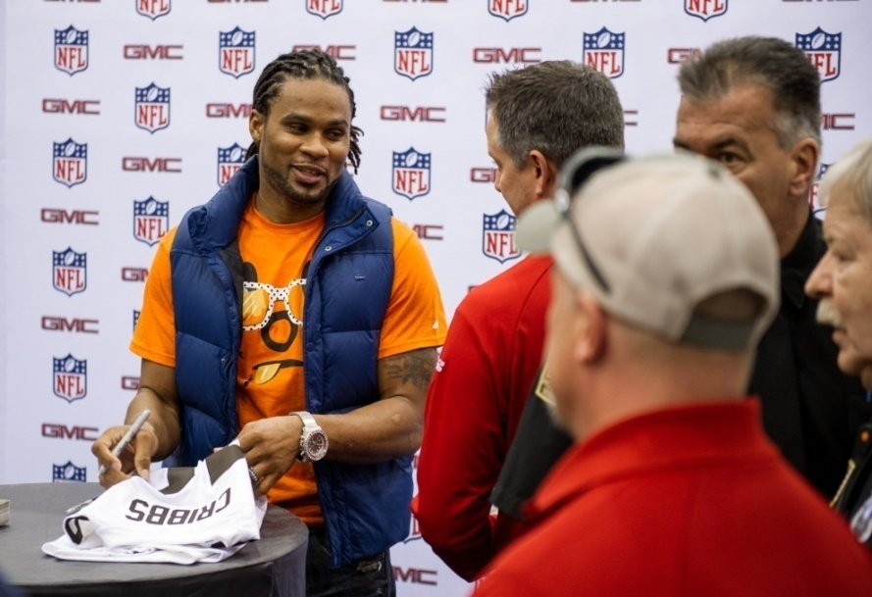
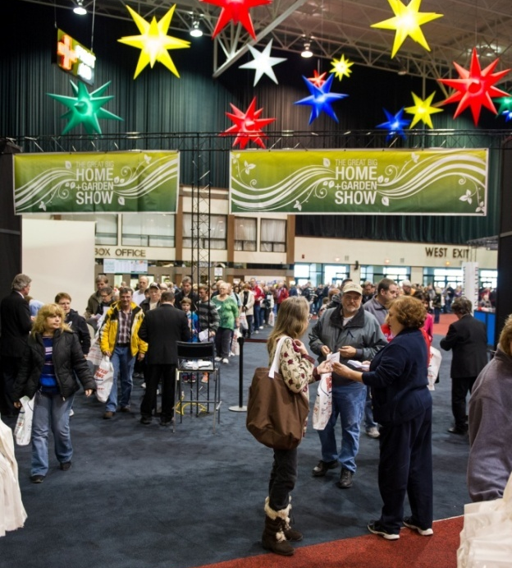
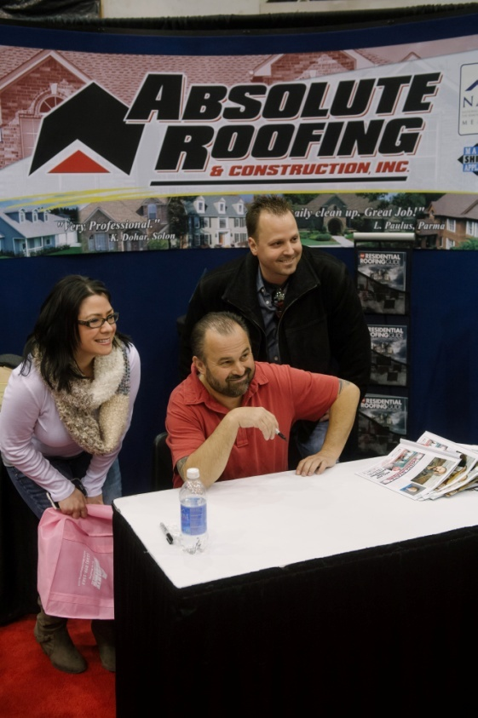
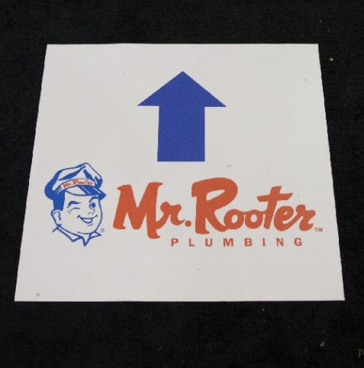
Marketing Opportunities at the Show
CELEBRITIES
ENTRANCE/EXIT
FLOOR DECALS

Slide 29

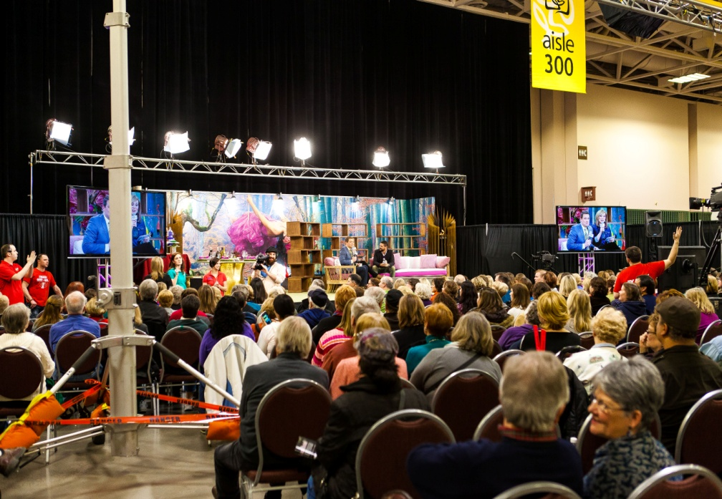
Marketing Opportunities at the Show
IDEA HOME
Lifestyle STAGE

Slide 30
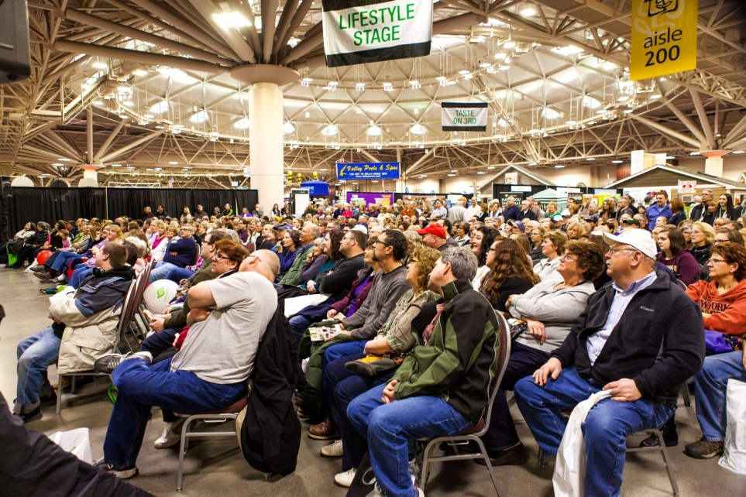
Sponsorship Opportunities…
Features
  Feature Gardens
  Lifestyle Stage/Cooking Stage
Official Product Sponsor
Celebrities & Experts on Main Stage
  Wings Financial Presenting Ty Pennington
Create your own…
  Girl’s Night Out
  Fashion Shows
  Do it yourself renovation area
  Electronics and technology area

Slide 31
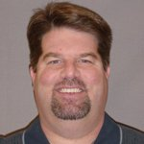
Joe Trimble
Regional
Sales Director

Slide 32
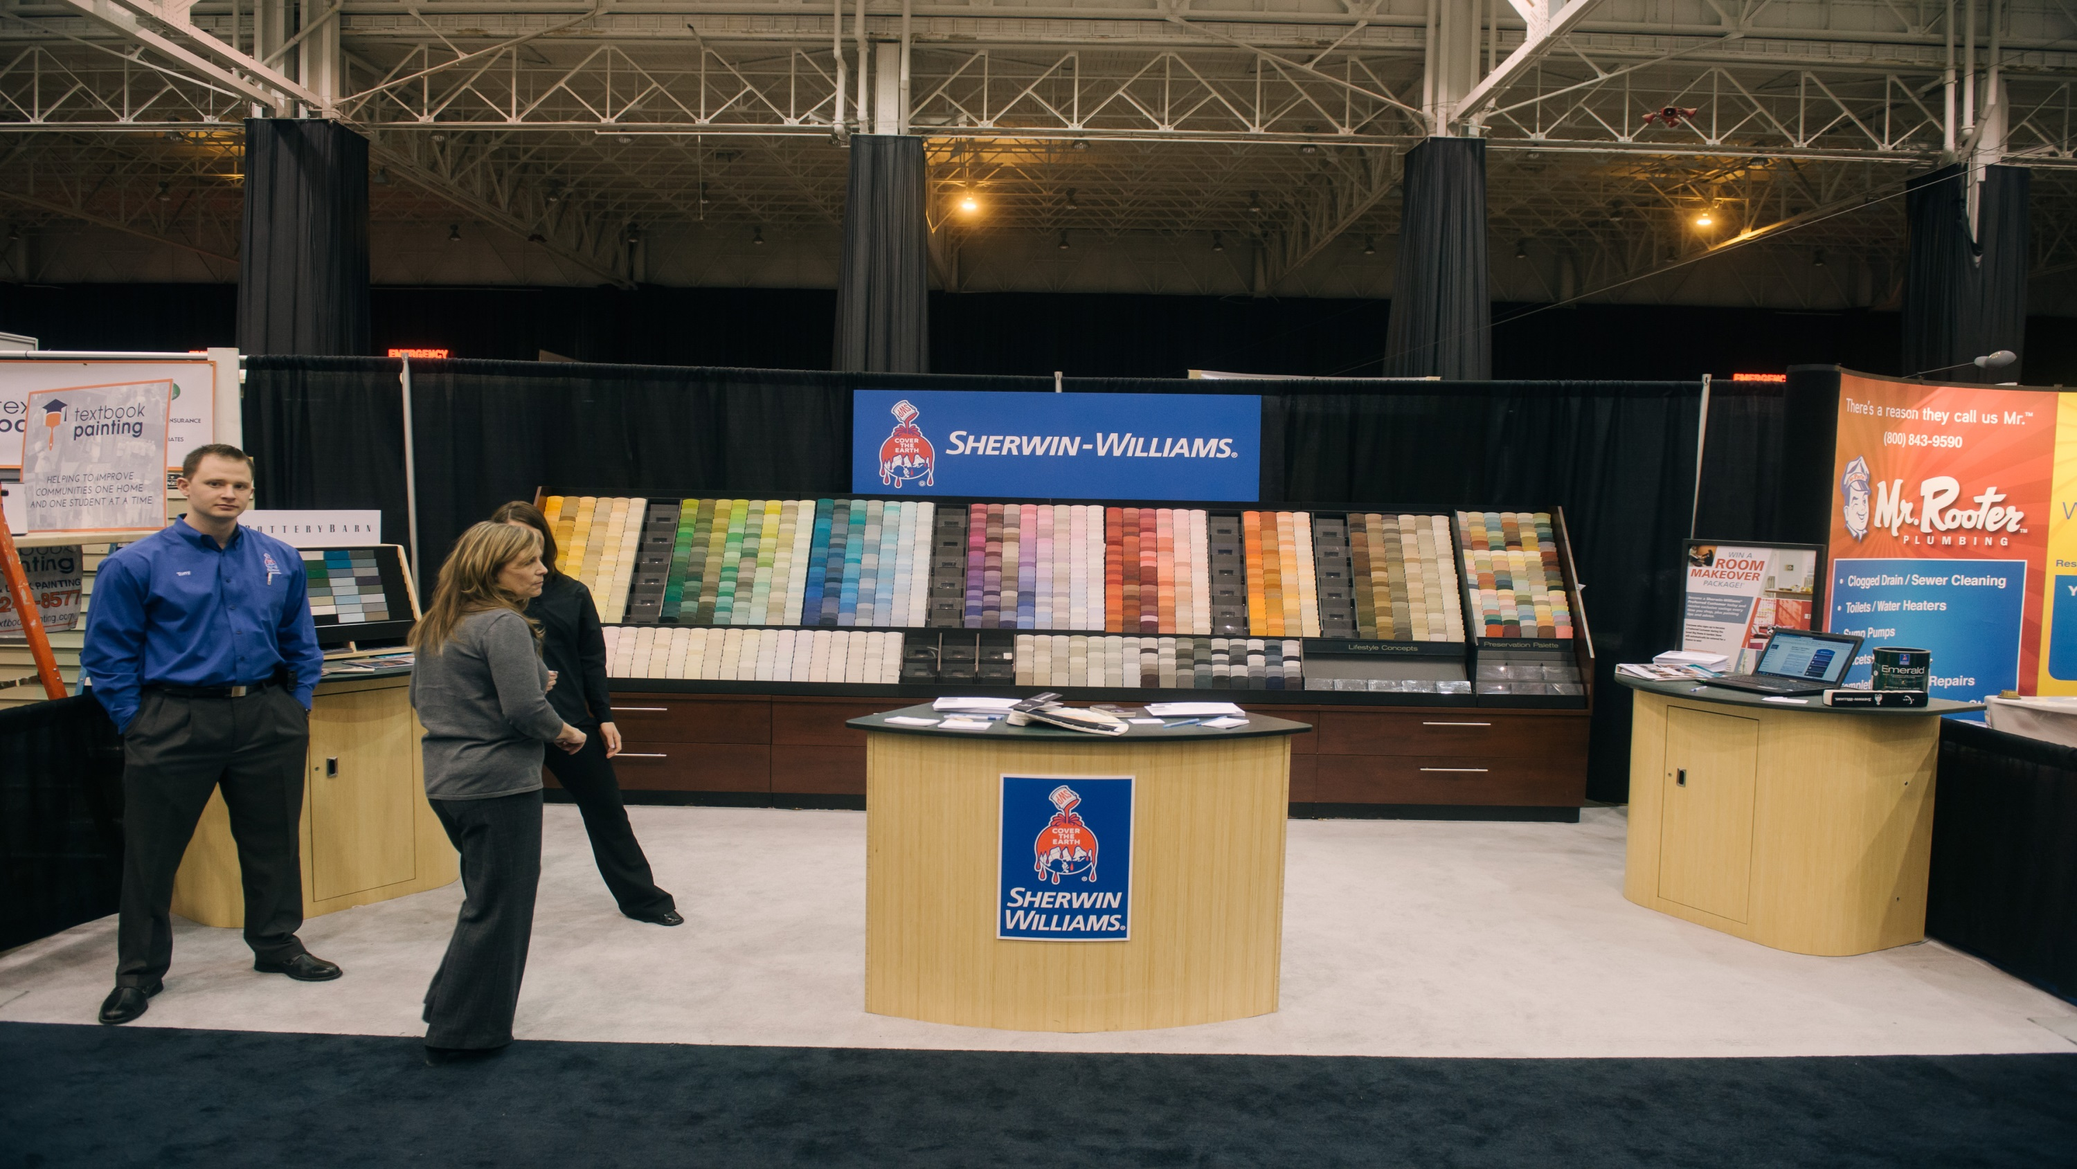
Exhibit Like an Expert
Notes:
Whether your Sherwin Williams, a globally recognized BRAND or
Your Generator Connection, a locally owned Cleveland business –
our home shows provide YOU face to face engagement
opportunities, something that NO other advertising outlet
provides.

Slide 33
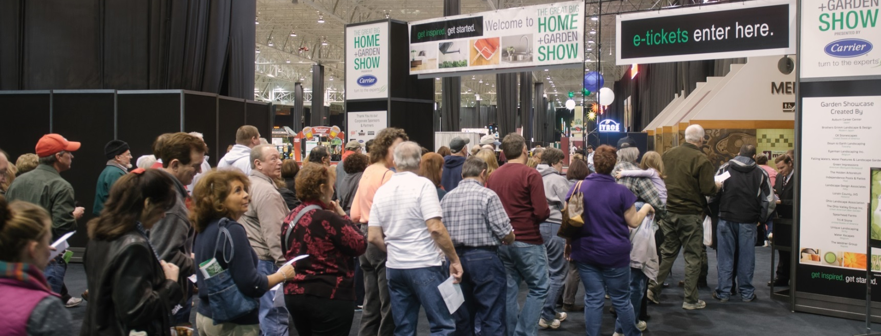
Face to Face Selling to Qualified Buyers
Vibrant Marketplace for Serious Shoppers
Permission Based Marketing / Sales
Notes:
Let me put this simply – if you DON’T EXHIBIT with us – you don’t get to play.
Our audience is coming to our shows with a project in mind. They will set appointments or purchase at the SHOW. They will NOT shop with businesses who are NOT exhibiting.

Slide 34
YOUR SAFEST BET. Period.
Notes:
Here’s a perfect example.
Total listening to radio in the 30 PPM (portable people meter) markets has declined by more than 43 since the year 2000.
The high water mark for radio listening????
Was in 1983
(along with big hair!)
Mark Ramsey, media strategist, 2014

Slide 35
Among exhibitors, the value of face-to-face interactions is also increasing. Most exhibitors place the highest value on in-person sales calls, exhibitions and conventions. Looking ahead to the next two years, exhibitors anticipate increased value on these face-to-face settings.
The Center for Exhibition Research
August 23, 2012

Slide 36
Tradeshowinsights.com
TOP 10 REASONS TO EXHIBIT
Introduce new products and/or services
Make on-the-spot sales
Meet potential customers & showcase to existing ones
Conduct market research (product testing)
Recruit new sales force
Gain names for mailing list (qualified leads)
Target a specific market segment
Create or enhance company image
Distribute product samples/special offers
Low advertising cost per person reached

Slide 37
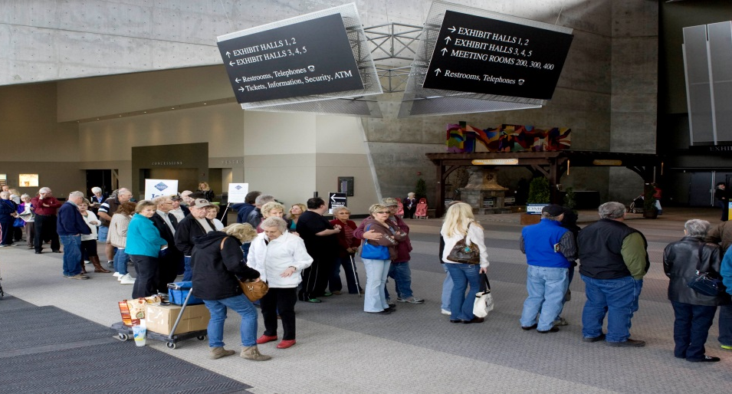
Attendee Cross-Over
Geotracking Analysis Emitted from Smart Phones
  Average cross-over audience in all instances was only 4%
  Different audiences at each show equates to different buyers at each show
Can you really afford to miss out an entire show’s worth of qualified buyers?
Notes:
We conducted geotracking analysis using data emitted from smartphones at 12 different shows in our Fall 2013/Spring 2014 markets, INCLUDING OUR TWO CLEVELAND SHOWS.
SAME DEMOGRAPHICS – DIFFERENT AUDIENCES.

Slide 38

Effective Pre-Show Planning
SMART GOALS
Sensible
Measurable
Attainable
Realistic
Truthful

Slide 39
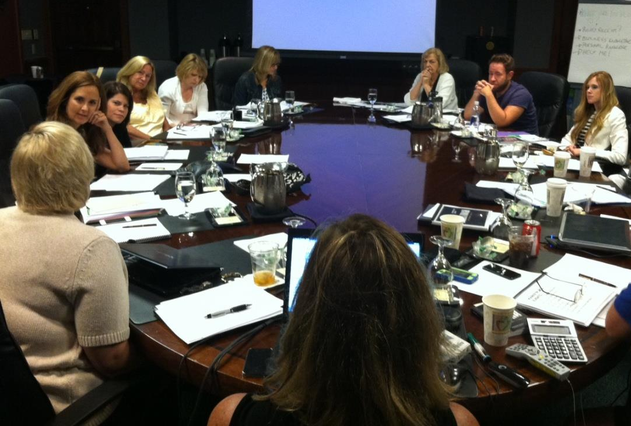
Show Goals
Set Goals
  Fact: less than 25% of exhibitors set goals
Share Goals

Slide 40
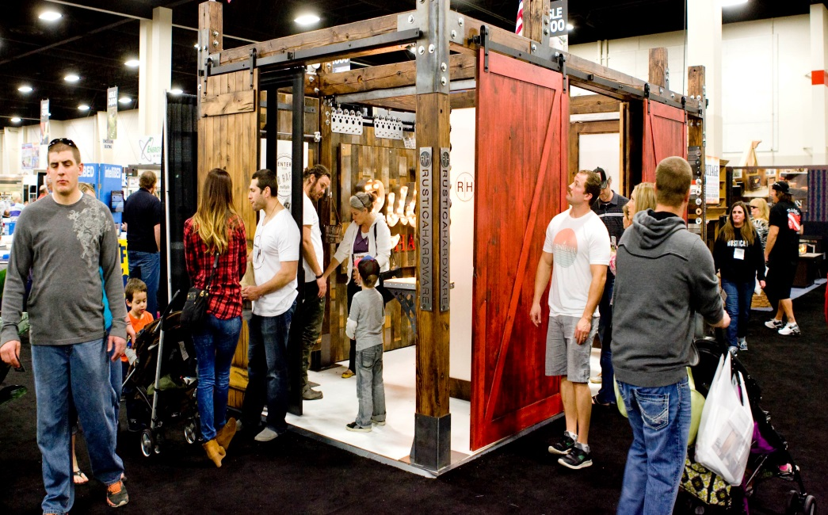
Decide How Much Space
Show Budget
Product Selection
Desired Objectives
10x10 space – 3 seconds, 3 steps

Slide 41

Must Do’s
Be in booth at Show OPEN and Show CLOSE
Keep It Simple
Have Fun
Engage
Notes:
Will Charm, President, with One Time Construction, 200 sq ft booth, first time customer in 2014 show, already booked for 2015 show!

Slide 42
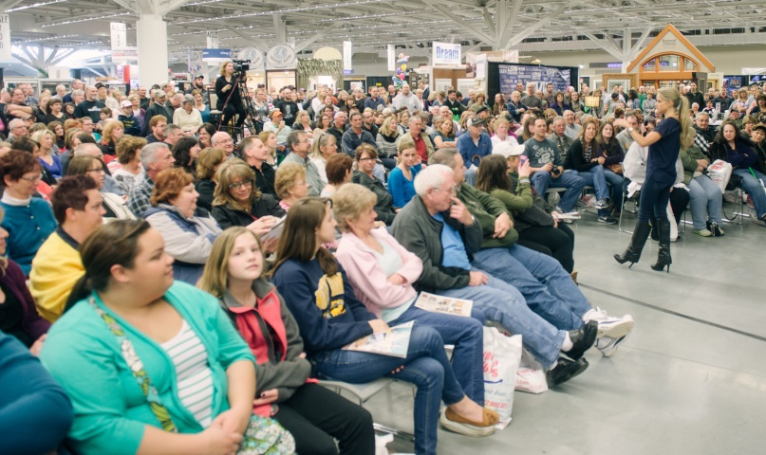
Selling Techniques
Ability to ASK QUESTIONS to distinguish qualified prospects
Ask OPEN ended questions
Job will be to sell the attendee on the BENEFITS of your product and company in a minimum amount of time, to determine:
  NEED
  DESIRE
  AFFORDABILITY
Notes:
Mention LEAD CARDS HERE – we will put up on WEBISTES under confirmed exhibitors

Slide 43

EXHIBIT SPACE DON’TS

Slide 44
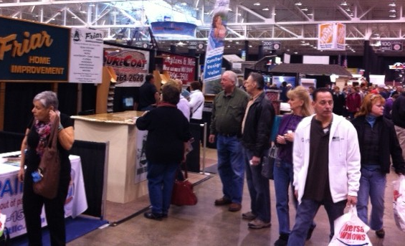
Show is open, where are you?

Slide 45
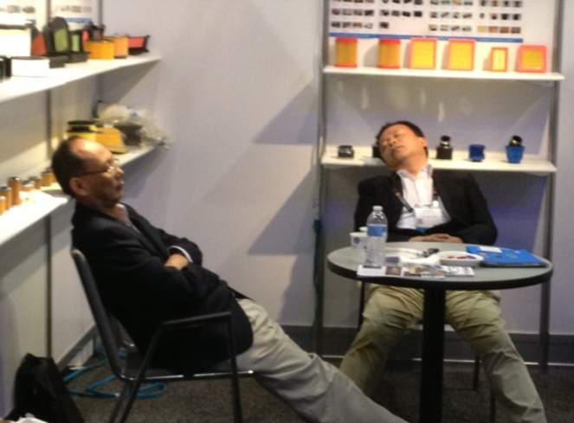
Sleeping in Booth

Slide 46
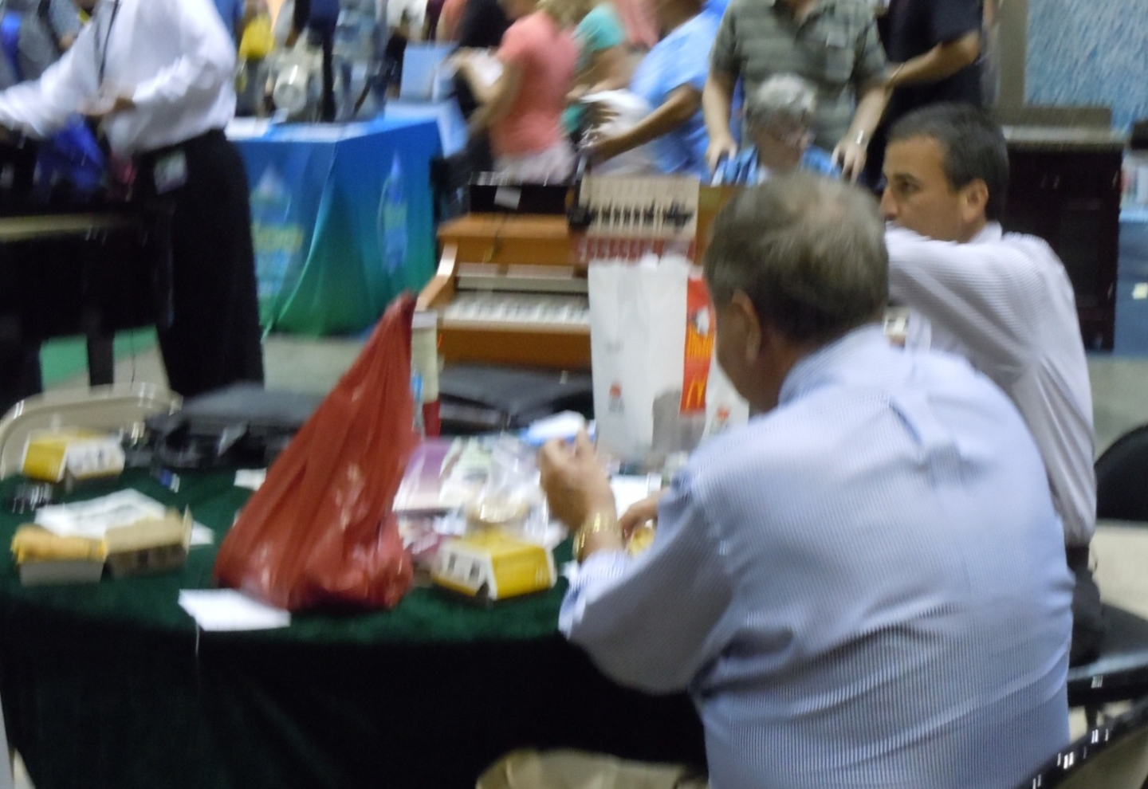
Eating in Booth

Slide 47
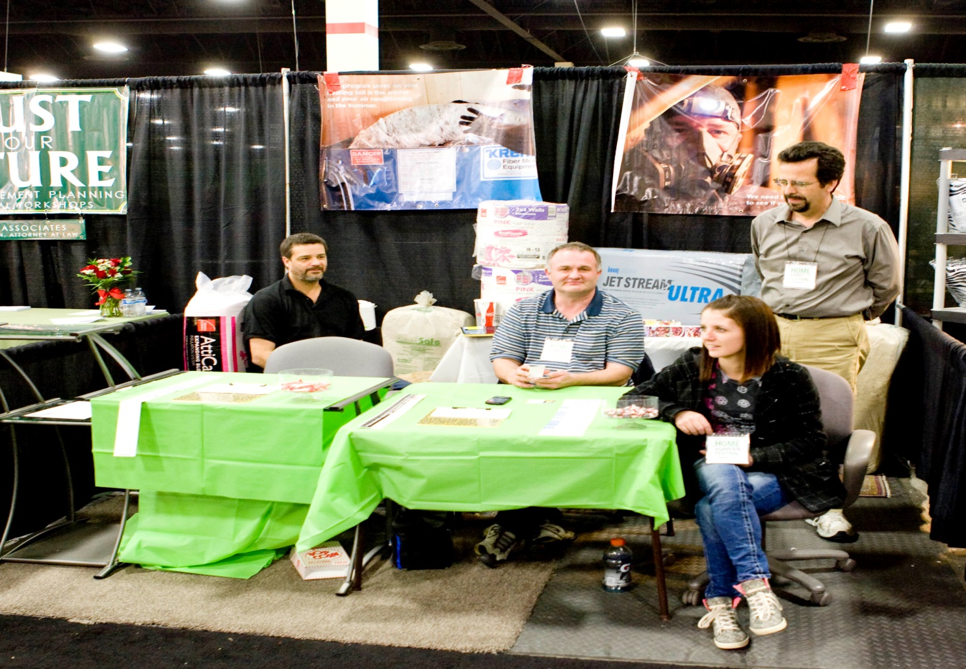
Flooring, table covers, food, tape showing and much more!

Slide 48
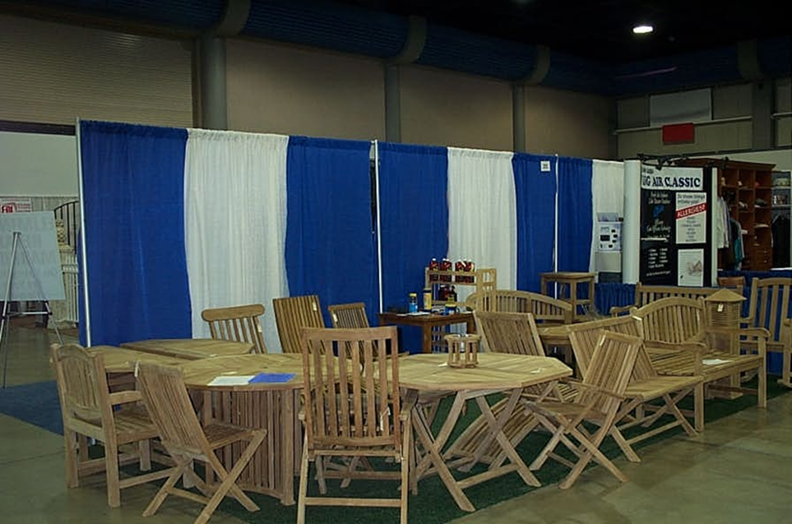
NO Signage or pricing, too much product
10x20 should be in at least 10x30

Slide 49
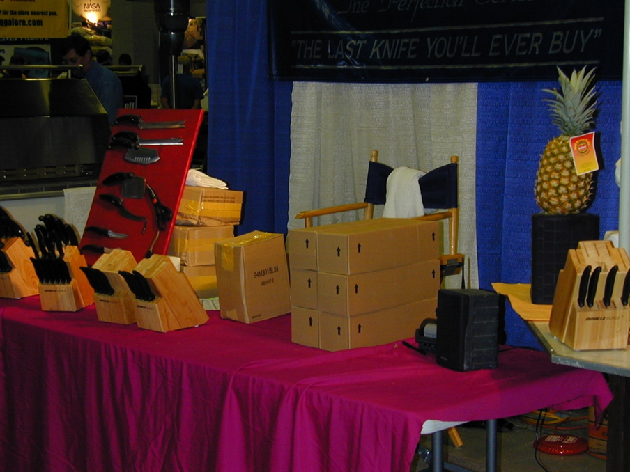
Messy

Slide 50
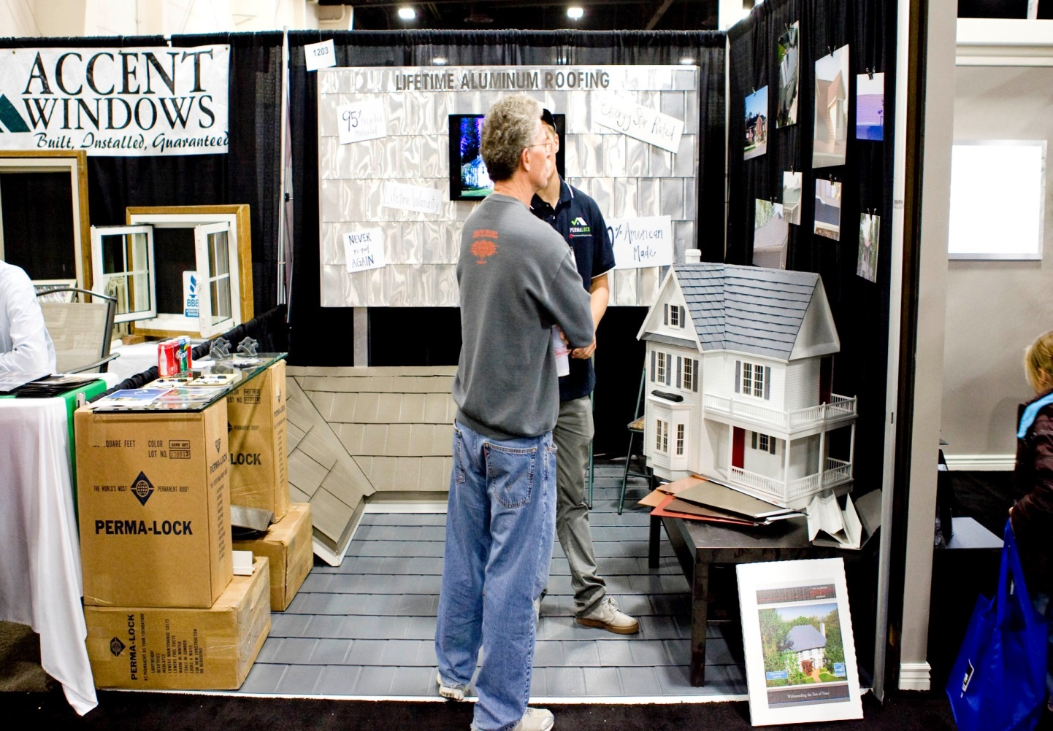
Needs Improvement

Slide 51
DON’T
Sit or read in your booth
Eat or drink in your booth
Chew gum in your booth
Ignore prospects
Talk or text on the phone
Attack the aisles
Overcrowd with staff
Display too much product literature

Slide 52

EXHIBIT SPACE DO’S

Slide 53
Carpet or Flooring is required in ALL BOOTHS
Is REQUIRED
Before You Get There

Slide 54
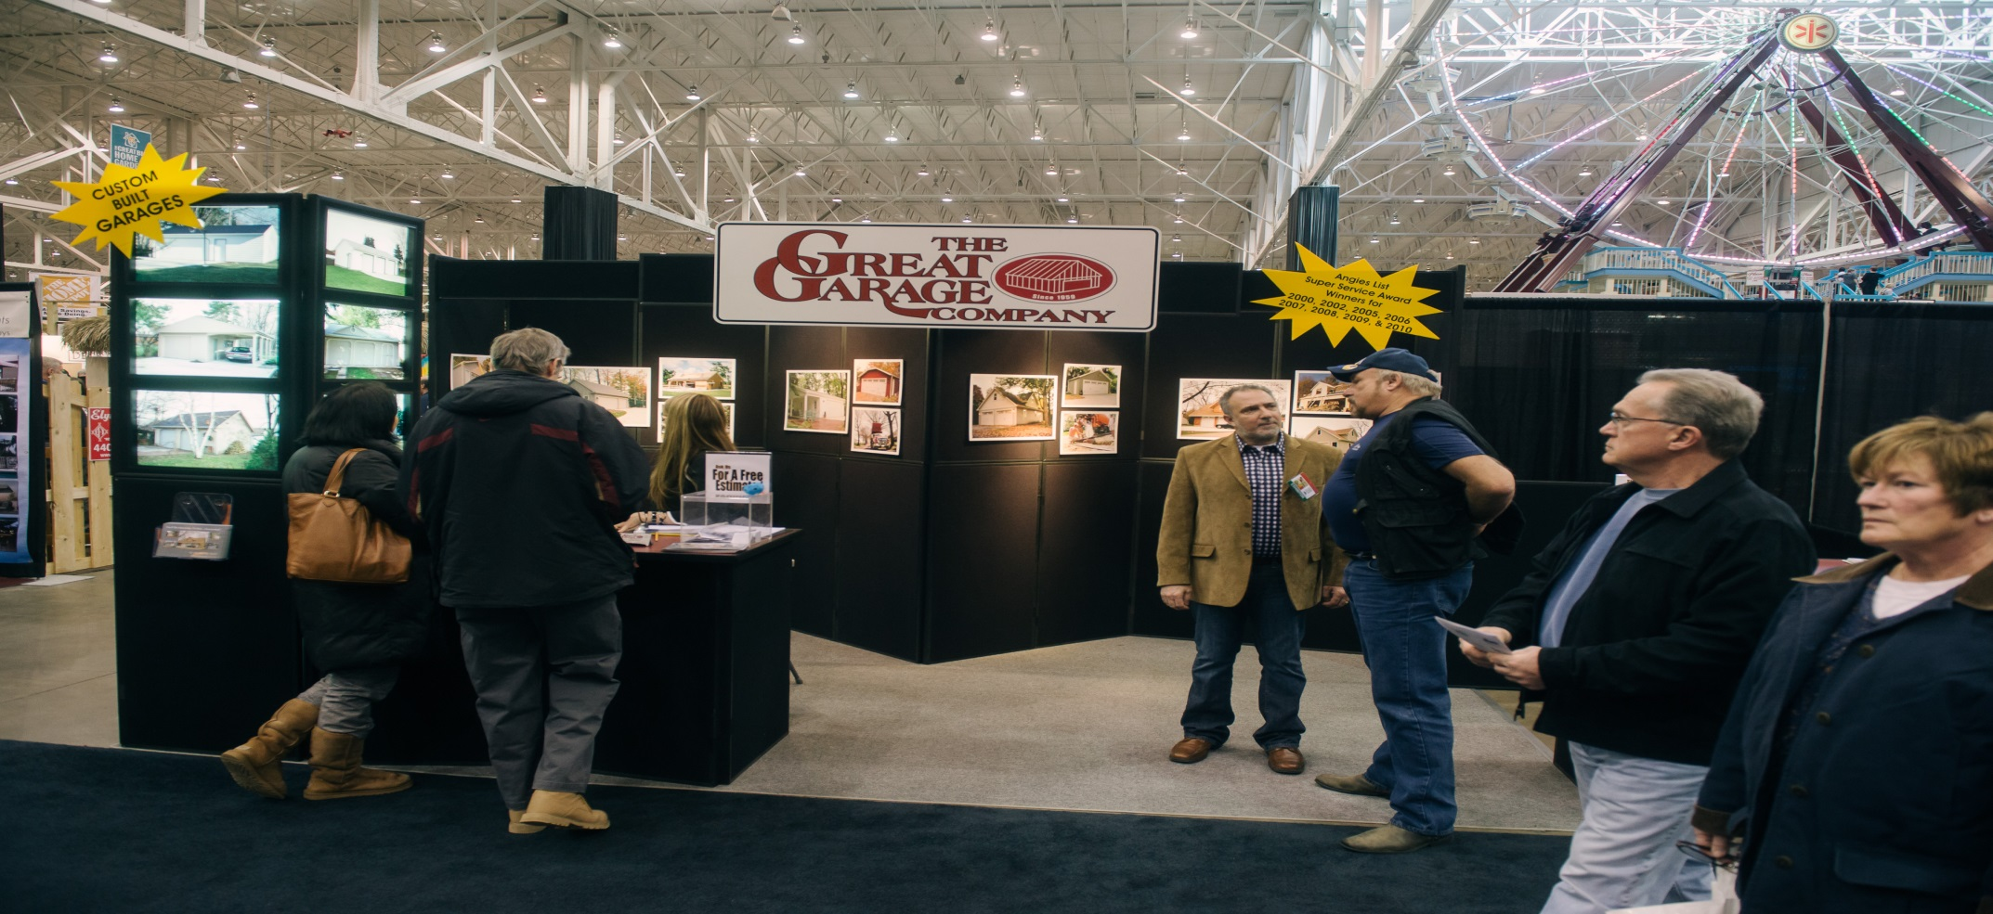
Literature and Giveaways - should be strategically planned
Neatness Counts
Interactive Demonstrations
Before You Get There
Notes:
John D’Amico from the Great Garage Company – sells more than $250k just from our show alone! Simple 10x20 space – VERY neat. Room to talk to multiple people at the same time.

Slide 55
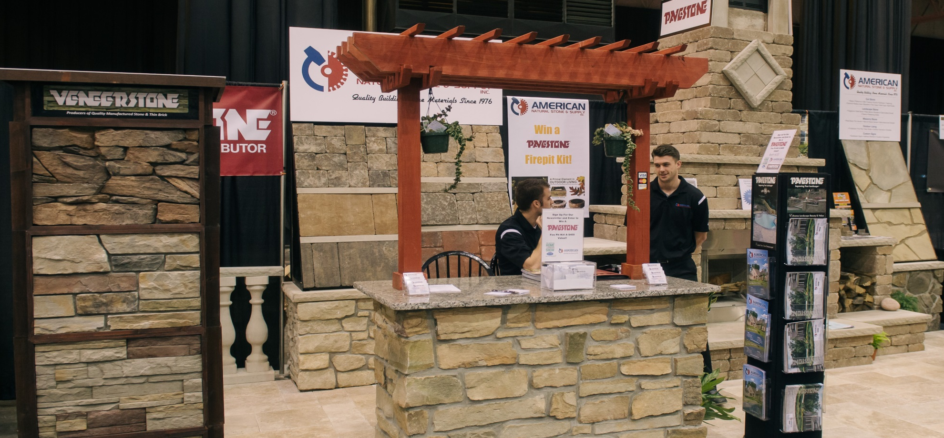
Dress Appropriately!
Notes:
AMERICAN NATURAL STONE
INCREASED THEIR SPACE FOR 2015 WENT FROM 200 TO 600 SQUARE FEET!

Slide 56
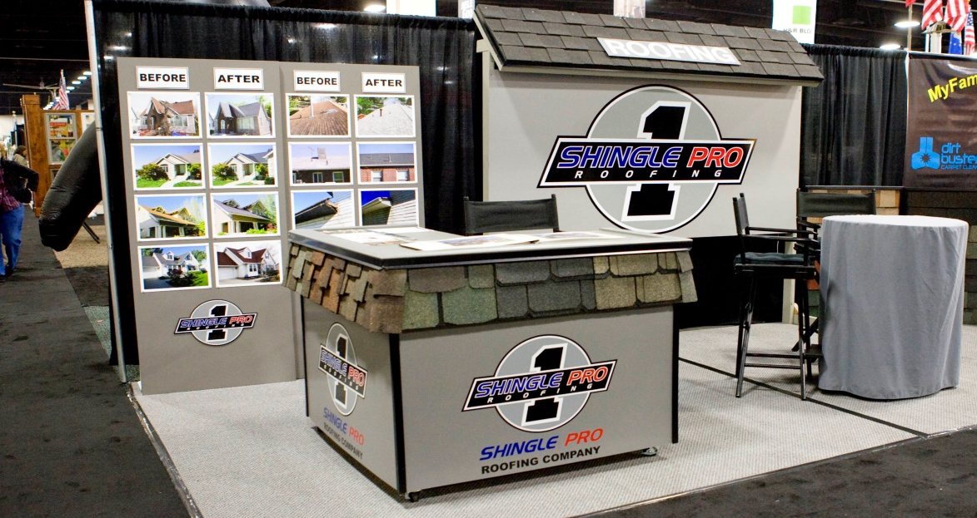
A sign is your introduction and handshake with those passing by, identifying your business to existing and potential customers.
U.S. SMALL BUSINESS ASSOCIATION

Slide 57
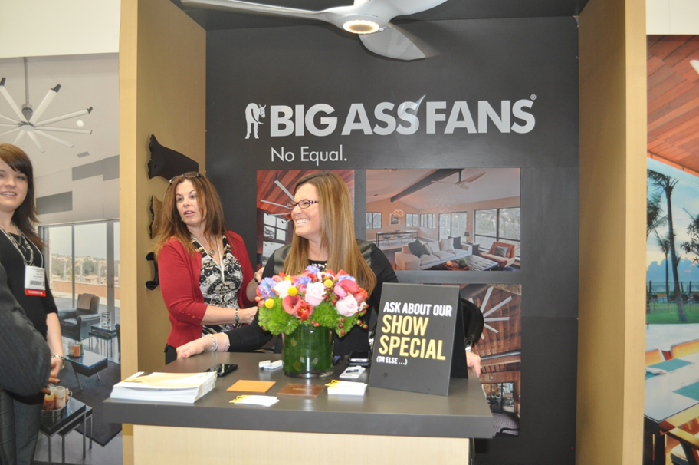
Be Creative
Communicate What Your Company Does

Slide 58

10x10 in line

Slide 59
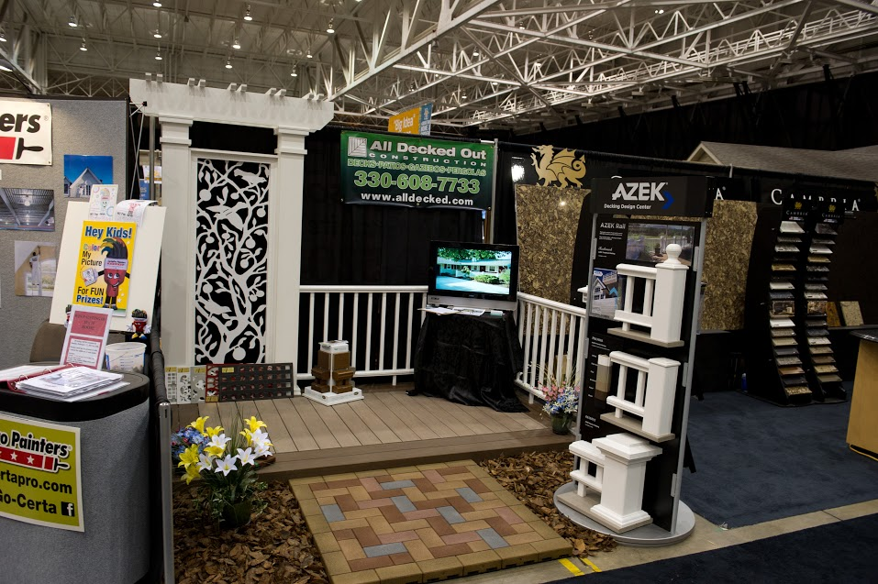
10x10 in line

Slide 60

10x20 Booth

Slide 61
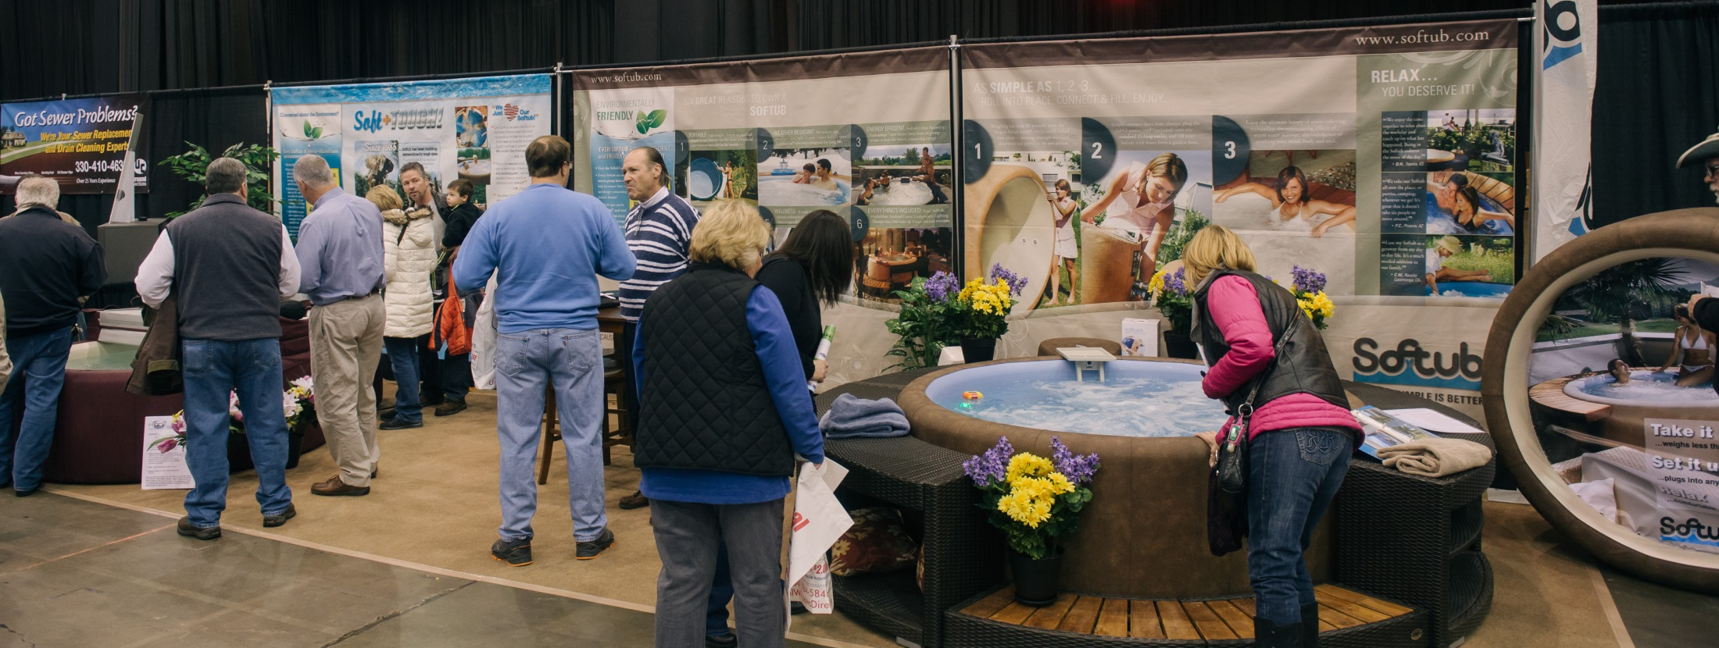
10x30 booth

Slide 62
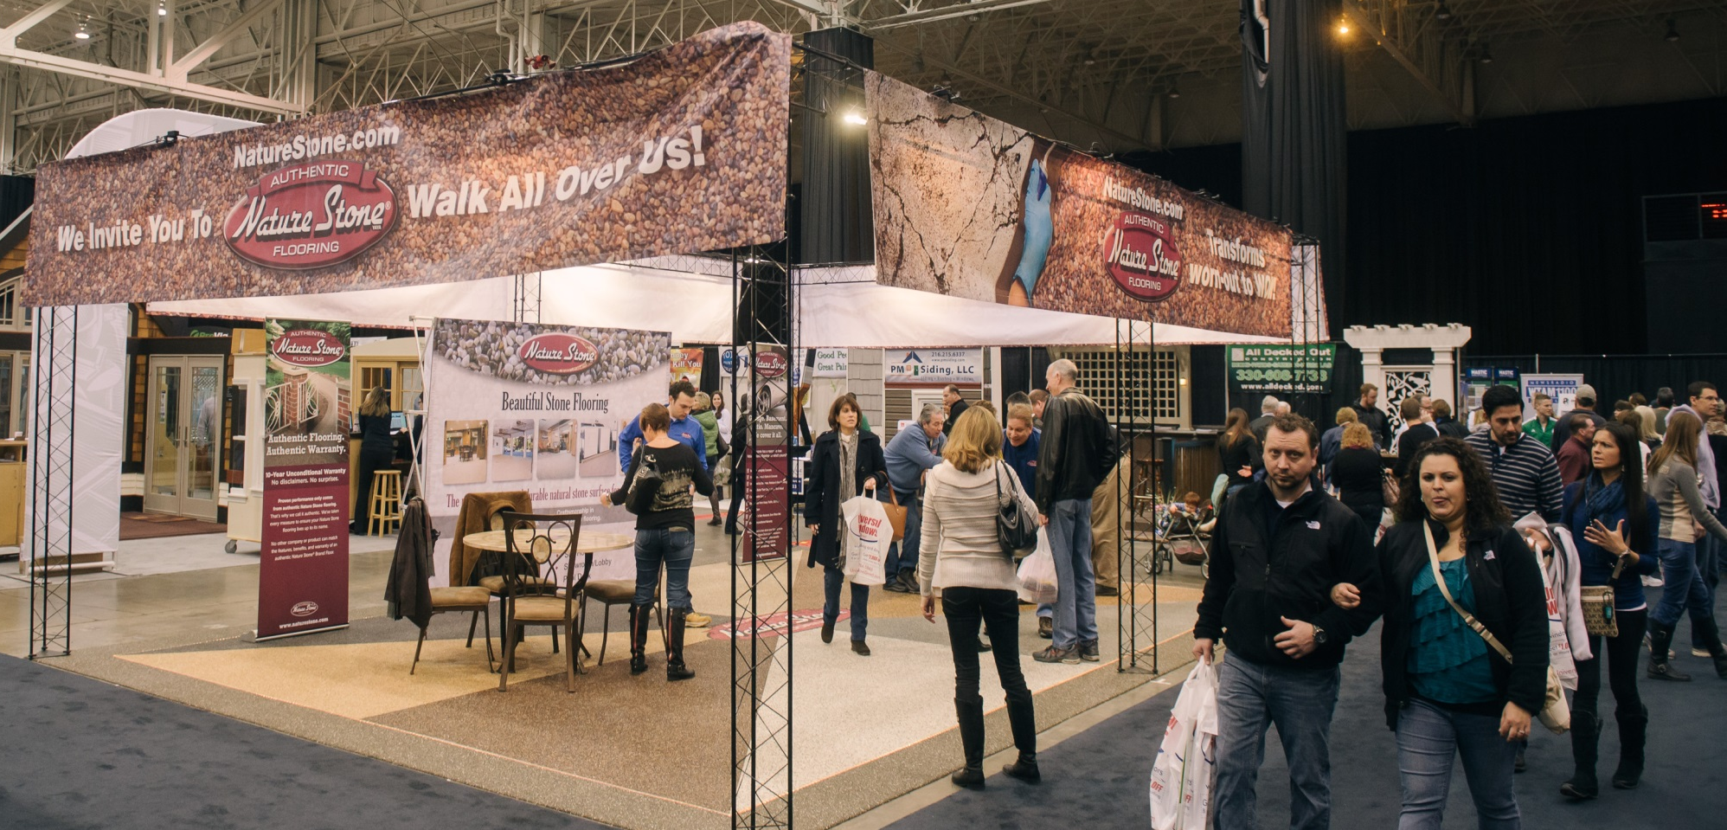
600 Sf Ft Island

Slide 63
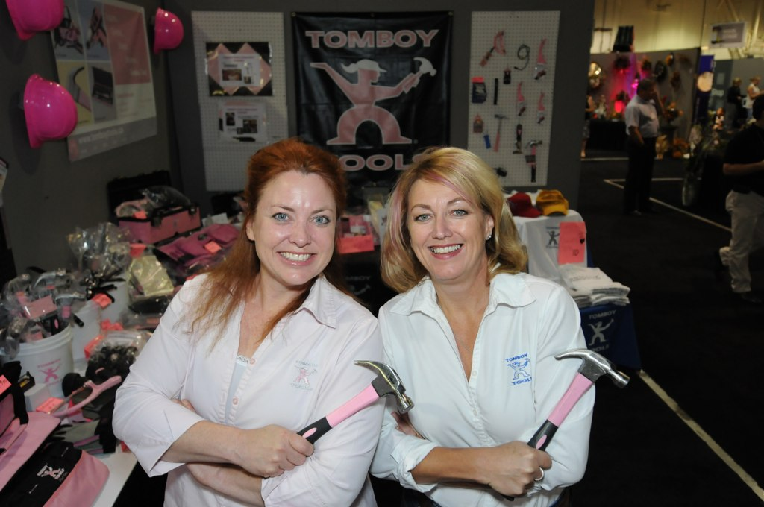
Selling Do’s
Smile☺ The first impression is the most important
Be enthusiastic
Be carefully groomed
Use prospect’s name
Know your competition
Make friends with your neighbors

Slide 64
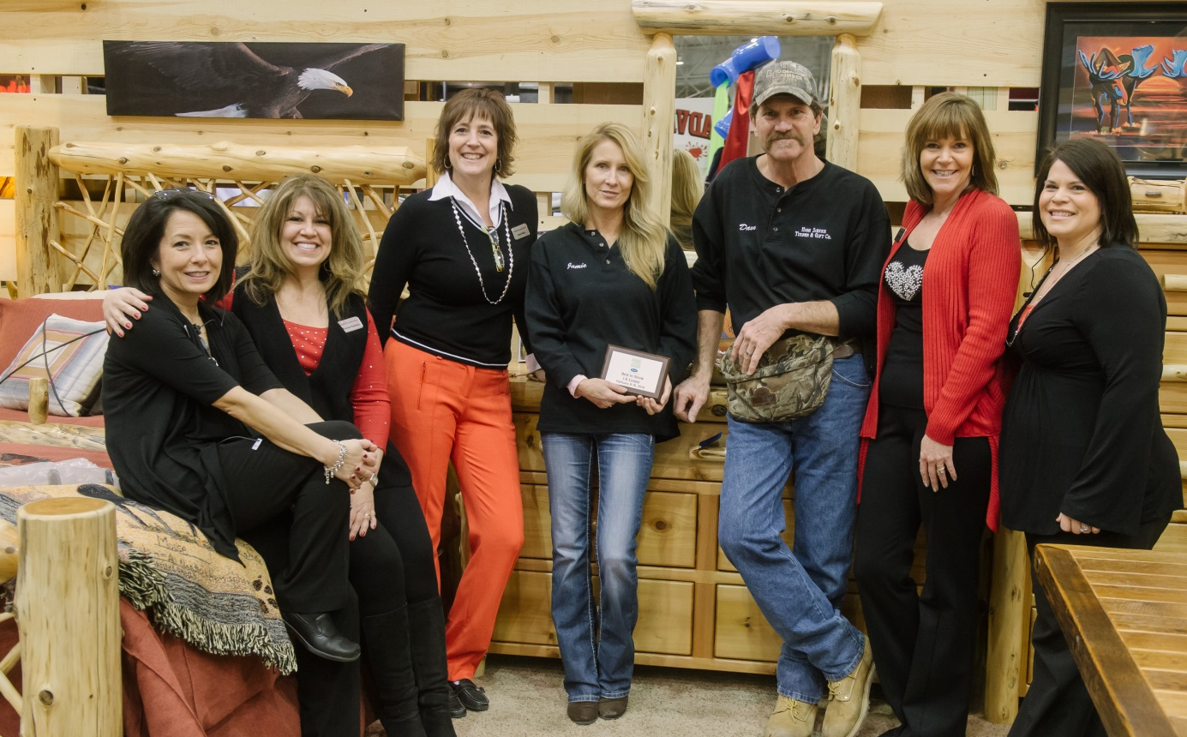
Exhibitor Booth Awards

Slide 65
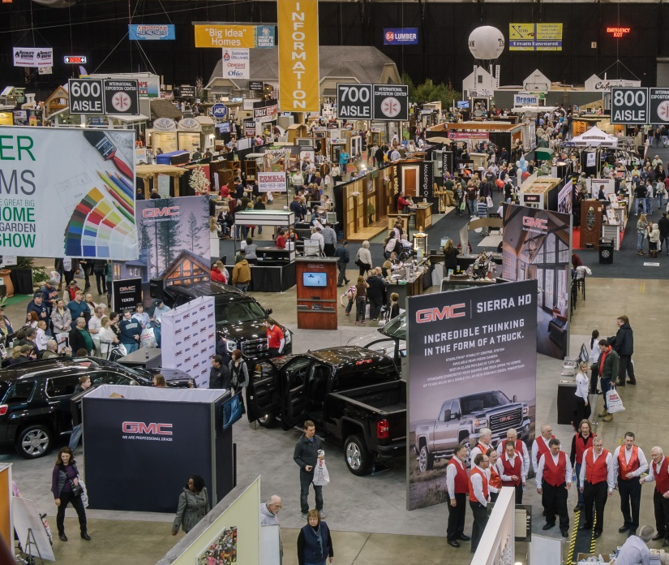
After the Show
Call on ALL leads
Consider a mailer, email blast to opt ins, etc.
Get feedback from employees
Provide feedback to show staff
Start planning for next show!

Slide 66
From our Exhibitors
After the Show
CELEBRATE!
Sales from show alone grew 50% year over year!
Show was fabulous!
Knocked it out of the park! 4 new jobs at $50,000 each!
87 qualified leads at show!
62 appointments!
160 leads, 30 more than last year!

Slide 67


Innovation Avenue
Go Ahead…..Be a Show Off!
Do you have a brand new product or service to show off this year?
Submit to
Innovation Avenue!
Sasha Andreev

Slide 68
Innovation Avenue
THE PERKS
Displayed on the main aisle of the show
Demonstrated in live presentations on lifestyle stage
Promoted in print advertising
Highlighted on show website
Covered by print and TV media
.....ALL FOR FREE!

Slide 69
Innovation Avenue
Deadline is JANUARY 15!
Submissions will be reviewed and selected by Sasha Andreev and Show Management
Questions? Email Martin or Sasha at HGSasha@gmail.com

Slide 70
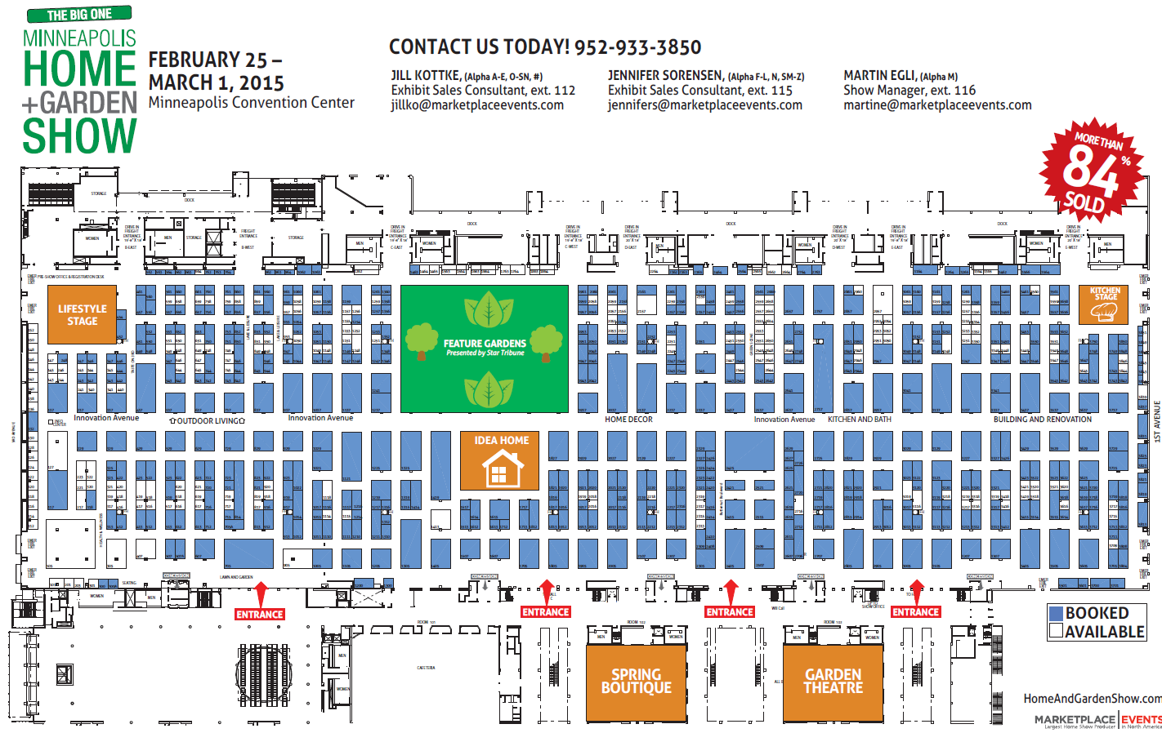

Slide 71
Thank you for coming, see you in February!

